Slide 1
PIA 3121
29 September 2026
Economic Structuralism
and Globalization

Slide 2
PIA 3121 Schedule
1 Sept: Tools of Analysis / Foundational Concepts
8 Sept: Realism
15 Sept: Liberalism
22 Sept: Neorealism and Neoliberalism
29 Sept: Economic Structuralism and Globalization
6 Oct: Constructivism
13 Oct: MIDTERM QUIZ
20 Oct: Ontological Security Theory
27 Oct: The English School
3 Nov: Democratization / Global Culture / Revolution
10 Nov: Critical Theory / Gender in IR / Global Civil Society
17 Nov: Chaos and Complexity in IR / Existential Risks
24 Nov: FINAL QUIZ / Discussion of Group Projects
8 Dec: GROUP PAPER PROJECT DUE

Slide 3

Possibly Realists are right that states were born as war-fighting machines and still tend toward suspicion of each other because of the security dilemma.
But over the ages, states that fail to cooperate will gradually be eliminated from the world scene. Completely naïve states will also be eliminated.
The surviving states will be those that prosper through the benefits cooperation confers when balanced by a vigorous—yet reasonable—defense of state interests.
SO REALISTS MUST RECONSIDER SEVERAL ISSUES: the world as anarchic today, the impossibility of progress, etc.

Slide 4
The Neo-Neo Debate
Neorealists responded to the Neoliberals’ core contribution by contending that its presuppositions are flawed:

Slide 5
The Neo-Neo Debate
Neorealists responded to the Neoliberals’ core contribution by contending that its presuppositions are flawed:
Neoliberals can only use “evolution of cooperation” models by assuming states primarily seek absolute gains in their interactions each other; that is, gains compared to the past or what would have been possible from alternative courses of action.

Slide 6
The Neo-Neo Debate
Neorealists responded to the Neoliberals’ core contribution by contending that its presuppositions are flawed:
Neoliberals can only use “evolution of cooperation” models by assuming states primarily seek absolute gains in their interactions each other; that is, gains compared to the past or what would have been possible from alternative courses of action.
But Neorealists assert that, owing to the security dilemma, states primarily seek relative gains in their interactions with each other. Peace may be passing!

Slide 7
The Neo-Neo Debate

Slide 8
The Neo-Neo Debate
1. Both sides agree that regimes exist and are important.

Slide 9
The Neo-Neo Debate
1. Both sides agree that regimes exist and are important.
2. Neorealists think powerful states are relatively less constrained by regime norms and rules.

Slide 10
The Neo-Neo Debate
1. Both sides agree that regimes exist and are important.
2. Neorealists think powerful states are relatively less constrained by regime norms and rules.
3. But Neoliberals insist that once regimes are created, they ensnare all states in webs of governance that profoundly undermine anarchy.

Slide 11
Economic Structuralists See Power Politics as Embedded in Economic Structures

Slide 12
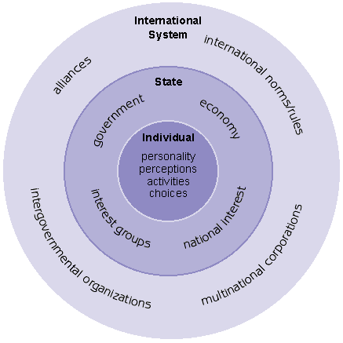
ANARCHY!

Slide 13


Slide 14
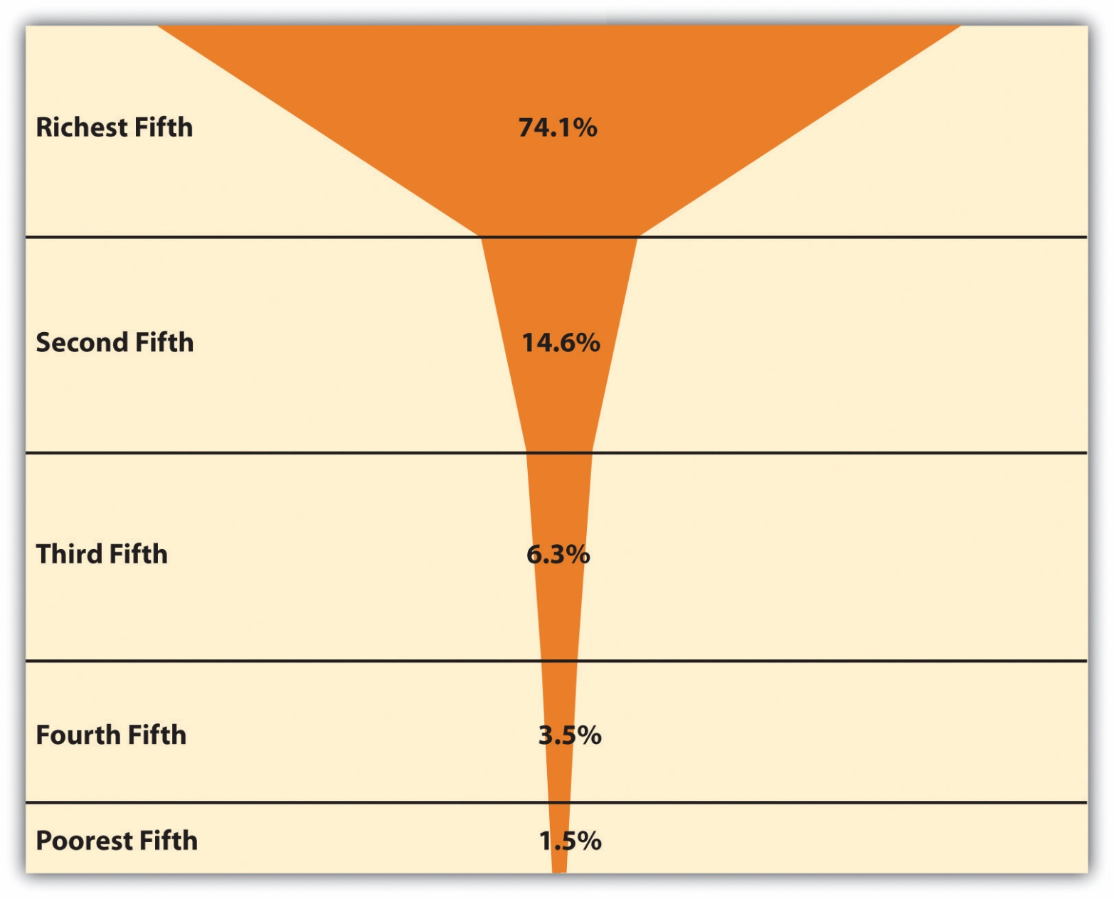
World Income Distribution
SOURCE: https://saylordotorg.github.io/text_sociology-understanding-and-changing-the-social-world-comprehensive-edition/s12-01-the-nature-and-extent-of-globa.html

Slide 16
Economic Structuralists See Power Politics as Embedded in Economic Structures
The State: The state is not seen as a sovereign entity primarily concerned with security in an anarchic world. Instead, its main function is to ensure the continuation of the capitalist mode of production. The state’s power, therefore, is significant only in how it aids or hinders the process of capital accumulation. Core states use their power to maintain the system that benefits them, while peripheral states are too weak to alter their subordinate role.

Slide 17
Economic Structuralists See Power Politics as Embedded in Economic Structures
The State: The state is not seen as a sovereign entity primarily concerned with security in an anarchic world. Instead, its main function is to ensure the continuation of the capitalist mode of production. The state’s power, therefore, is significant only in how it aids or hinders the process of capital accumulation. Core states use their power to maintain the system that benefits them, while peripheral states are too weak to alter their subordinate role.
The Balance of Power: World-system theorists like Wallerstein analyze the distribution of power, but they argue it's a consequence of the world-economy, not the primary cause of events. They would contend that realists focus on the balance of power but fail to see that “there are important economic processes at work that are critical in accounting for the particular distribution of capabilities or balance of power in the first place.”

Slide 18
Economic Structuralists See Power Politics as Embedded in Economic Structures
The State: The state is not seen as a sovereign entity primarily concerned with security in an anarchic world. Instead, its main function is to ensure the continuation of the capitalist mode of production. The state’s power, therefore, is significant only in how it aids or hinders the process of capital accumulation. Core states use their power to maintain the system that benefits them, while peripheral states are too weak to alter their subordinate role.
The Balance of Power: World-system theorists like Wallerstein analyze the distribution of power, but they argue it's a consequence of the world-economy, not the primary cause of events. They would contend that realists focus on the balance of power but fail to see that “there are important economic processes at work that are critical in accounting for the particular distribution of capabilities or balance of power in the first place.”
Anarchy: Political anarchy is also acknowledged, but its effect is viewed differently. Rather than causing a security dilemma, the absence of a central political authority facilitates the development and expansion of world capitalism because no single state can control the entire world economy.

Slide 19
The Distinctive Model of Antonio Gramsci (1891-1937): World Hegemony

Slide 20
The Distinctive Model of Antonio Gramsci (1891-1937): World Hegemony
Beyond Economic Determinism: Gramsci offered a more volitional (less deterministic) approach to Marxism, arguing that power is maintained not just through economic or physical force, but through ideas, culture, and consent.

Slide 21
The Distinctive Model of Antonio Gramsci (1891-1937): World Hegemony
Beyond Economic Determinism: Gramsci offered a more volitional (less deterministic) approach to Marxism, arguing that power is maintained not just through economic or physical force, but through ideas, culture, and consent.
Core Concept – Hegemony: The dominance of a ruling class is fully achieved only when its social vision and values are accepted by the subordinate classes as common sense. This is achieved by manufacturing consent, not just coercion.

Slide 22
The Distinctive Model of Antonio Gramsci (1891-1937): World Hegemony
Beyond Economic Determinism: Gramsci offered a more volitional (less deterministic) approach to Marxism, arguing that power is maintained not just through economic or physical force, but through ideas, culture, and consent.
Core Concept – Hegemony: The dominance of a ruling class is fully achieved only when its social vision and values are accepted by the subordinate classes as common sense. This is achieved by manufacturing consent, not just coercion.
The Historic Bloc: Hegemony is built through a “historic bloc” which fuses the material economic base of society (structure) with the ideological and cultural realms (superstructure) like schools, media, and religion.

Slide 23
The Distinctive Model of Antonio Gramsci (1891-1937): World Hegemony
Beyond Economic Determinism: Gramsci offered a more volitional (less deterministic) approach to Marxism, arguing that power is maintained not just through economic or physical force, but through ideas, culture, and consent.
Core Concept – Hegemony: The dominance of a ruling class is fully achieved only when its social vision and values are accepted by the subordinate classes as common sense. This is achieved by manufacturing consent, not just coercion.
The Historic Bloc: Hegemony is built through a “historic bloc” which fuses the material economic base of society (structure) with the ideological and cultural realms (superstructure) like schools, media, and religion.
The Role of Civil Society: Civil society is the primary terrain where this consent is manufactured and institutionalized. It is also the battleground where subordinate groups can challenge the dominant ideology by developing a counter-hegemony.

Slide 24
The Distinctive Model of Antonio Gramsci (1891-1937): World Hegemony
Beyond Economic Determinism: Gramsci offered a more volitional (less deterministic) approach to Marxism, arguing that power is maintained not just through economic or physical force, but through ideas, culture, and consent.
Core Concept – Hegemony: The dominance of a ruling class is fully achieved only when its social vision and values are accepted by the subordinate classes as common sense. This is achieved by manufacturing consent, not just coercion.
The Historic Bloc: Hegemony is built through a “historic bloc” which fuses the material economic base of society (structure) with the ideological and cultural realms (superstructure) like schools, media, and religion.
The Role of Civil Society: Civil society is the primary terrain where this consent is manufactured and institutionalized. It is also the battleground where subordinate groups can challenge the dominant ideology by developing a counter-hegemony.
Application to IR: In IR, this concept helps explain world hegemony, where a dominant global class (transnational capital) and core states promote “universal” norms and institutions (e.g., IMF, World Bank) that legitimize and perpetuate the global capitalist system.

Slide 25
Gramsci’s Explanation for the Outbreak of World War I (1914-1918)

Slide 26
Gramsci’s Explanation for the Outbreak of World War I (1914-1918)
Gramsci viewed World War I NOT as an inevitable clash of states driven by MULTIPOLARITY under anarchy, but as a continental civil war that signaled the terminal crisis of the 19th-century bourgeois order.

Slide 27
Gramsci’s Explanation for the Outbreak of World War I (1914-1918)
Gramsci viewed World War I NOT as an inevitable clash of states driven by MULTIPOLARITY under anarchy, but as a continental civil war that signaled the terminal crisis of the 19th-century bourgeois order.
Failure of the Bourgeois Hegemonic Project: Gramsci saw the European bourgeoisie (the ruling class) as having failed to create a genuine historic bloc that incorporated the masses. Their form of capitalism was narrowly nationalistic and exploitative, and they ruled through dominance and weak consent.

Slide 28
Gramsci’s Explanation for the Outbreak of World War I (1914-1918)
Gramsci viewed World War I NOT as an inevitable clash of states driven by MULTIPOLARITY under anarchy, but as a continental civil war that signaled the terminal crisis of the 19th-century bourgeois order.
Failure of the Bourgeois Hegemonic Project: Gramsci saw the European bourgeoisie (the ruling class) as having failed to create a genuine historic bloc that incorporated the masses. Their form of capitalism was narrowly nationalistic and exploitative, and they ruled through dominance and weak consent.
“Passive Revolution:” The 19th century modernizing and state-building European elites had said, "We must change things so that everything stays the same." They introduced modernizing reforms and initiated some social welfare schemes, but only to the extent necessary to prevent a genuine, popular uprising that would threaten their own power. The masses did not participate.

Slide 29
Gramsci’s Explanation for the Outbreak of World War I (1914-1918)
Gramsci viewed World War I NOT as an inevitable clash of states driven by MULTIPOLARITY under anarchy, but as a continental civil war that signaled the terminal crisis of the 19th-century bourgeois order.
Failure of the Bourgeois Hegemonic Project: Gramsci saw the European bourgeoisie (the ruling class) as having failed to create a genuine historic bloc that incorporated the masses. Their form of capitalism was narrowly nationalistic and exploitative, and they ruled through dominance and weak consent.
“Passive Revolution:” The 19th century modernizing and state-building European elites had said, "We must change things so that everything stays the same." They introduced modernizing reforms and initiated some social welfare schemes, but only to the extent necessary to prevent a genuine, popular uprising that would threaten their own power. The masses did not participate.
The War as Catastrophic “Solution:” Faced with rising socialist movements and intense class struggle at home (a crisis of their domestic hegemony), the national bourgeoisies of Europe channeled these internal tensions outward into a catastrophic nationalist war. The war was an attempt to forcibly re-forge national unity by mobilizing the masses against an external enemy.

Slide 30
The Gramscian Theory of Other Small- and Medium Sized (Non-“Systemic”) Wars

Slide 31
The Gramscian Theory of Other Small- and Medium Sized (Non-“Systemic”) Wars
Nationalism as a Hegemonic Tool: Elites manufacture consent for their rule by using nationalism to create the historic bloc, framing their own class interests as the “national interest.” This creates a powerful (false) “us vs. them” narrative.

Slide 32
The Gramscian Theory of Other Small- and Medium Sized (Non-“Systemic”) Wars
Nationalism as a Hegemonic Tool: Elites manufacture consent for their rule by using nationalism to create the historic bloc, framing their own class interests as the “national interest.” This creates a powerful (false) “us vs. them” narrative.
Diversionary Wars (A Crisis of Hegemony): When an elite's domestic hegemonic project fails (e.g., due to economic crisis or political corruption), consent breaks down. To prevent a challenge from below, elites may initiate a diversionary war against a neighbor to stoke nationalist fervor and rally the population to their side.

Slide 33
The Gramscian Theory of Other Small- and Medium Sized (Non-“Systemic”) Wars
Nationalism as a Hegemonic Tool: Elites manufacture consent for their rule by using nationalism to create the historic bloc, framing their own class interests as the “national interest.” This creates a powerful (false) “us vs. them” narrative.
Diversionary Wars (A Crisis of Hegemony): When an elite's domestic hegemonic project fails (e.g., due to economic crisis or political corruption), consent breaks down. To prevent a challenge from below, elites may initiate a diversionary war against a neighbor to stoke nationalist fervor and rally the population to their side.
Internal Wars (Crushing Counter-Hegemony): Civil wars, insurgencies, or the violent suppression of ethnic minorities can be understood as the state using its coercive power to crush a counter-hegemonic movement. The state frames this internal repression as a necessary fight to preserve national unity against “terrorists” or “subversives,” thus reinforcing its own legitimacy.

Slide 34
The Gramscian Theory of Other Small- and Medium Sized (Non-“Systemic”) Wars
Nationalism as a Hegemonic Tool: Elites manufacture consent for their rule by using nationalism to create the historic bloc, framing their own class interests as the “national interest.” This creates a powerful (false) “us vs. them” narrative.
Diversionary Wars (A Crisis of Hegemony): When an elite's domestic hegemonic project fails (e.g., due to economic crisis or political corruption), consent breaks down. To prevent a challenge from below, elites may initiate a diversionary war against a neighbor to stoke nationalist fervor and rally the population to their side.
Internal Wars (Crushing Counter-Hegemony): Civil wars, insurgencies, or the violent suppression of ethnic minorities can be understood as the state using its coercive power to crush a counter-hegemonic movement. The state frames this internal repression as a necessary fight to preserve national unity against “terrorists” or “subversives,” thus reinforcing its own legitimacy.
Proxy Wars (Serving World Hegemony): A smaller war may also be a proxy conflict. In this scenario, a Core power supports a peripheral state's conflict against a neighboring regime that is resisting the global hegemonic order. The war serves the Core's interest in disciplining rogue actors and maintaining the stability of the overall capitalist world-system.

Slide 35
How Economic Structuralists
Account for SYSTEMIC Wars, like these:
1. The Italian and Indian Ocean Wars (1494-1517): This series of conflicts marked the shift from an older system of competing Italian city-states (like Venice) to the first oceanic, global power -- Portugal.
2. The Dutch Wars of Independence (c. 1580-1609): This long struggle represented the decline of the land-based Spanish and Portuguese empires and the rise of a new kind of commercial sea power, establishing the Netherlands as the next hegemon.
3. The Wars of Louis XIV (c. 1688-1713): This series of conflicts was a struggle against the territorial ambitions of France, the primary continental challenger. Led to the decline of the Netherlands and the rise of Great Britain as the new world leader, based on its growing command of the seas and superior ability to finance its wars.

Slide 36
How Economic Structuralists
Account for SYSTEMIC Wars, like these:
4. The French Revolutionary & Napoleonic Wars (1792-1815): This was a massive, continent-spanning conflict to contain the revolutionary and imperial ambitions of Napoleonic France. Re-established and solidified Great Britain's global leadership, based on Britain's unrivaled industrial supremacy and naval power.
5. The World Wars I & II (1914-1945): A hugely complex pair of wars that resulted in the exhaustion and collapse of the British-led European order and established the United States as the new global hegemon, since it also (with China and others) vanquished Japan in East Asia.
NOTE that the Qing conquest of Ming China and adjacent polities in the mid-1600s, while a massive and world-historical event, was not a global or systemic war within the context of the capitalist world-economy because, at the time it occurred, China was still largely an external arena to that system.

Slide 37
How Economic Structuralists
Account for SYSTEMIC Wars
Primarily by using the concept of “hegemonic cycles:”

Slide 38
How Economic Structuralists
Account for SYSTEMIC Wars
Primarily by using the concept of “hegemonic cycles:”
Periods of Cooperation (Hegemonic Stability): A period of relative peace and cooperation, like the one from roughly 1945 to 2000, corresponds to the peak of a hegemonic cycle. During this phase, a single core power (the hegemon) is so dominant economically that it can structure the world-economy to its advantage (e.g., by putting international regimes into place). BUT: cooperation prevails because the other great powers profit from the system as well.

Slide 39
How Economic Structuralists
Account for SYSTEMIC Wars
Primarily by using the concept of “hegemonic cycles:”
Periods of Cooperation (Hegemonic Stability): A period of relative peace and cooperation, like the one from roughly 1945 to 2000, corresponds to the peak of a hegemonic cycle. During this phase, a single core power (the hegemon) is so dominant economically that it can structure the world-economy to its advantage (e.g., by putting international regimes into place). BUT: cooperation prevails because the other great powers profit from the system as well.
Periods of Conflict (Hegemonic Decline and Rivalry): The world capitalist system inevitably leads to the rise of new economic power centers that begin to challenge the hegemon's dominance. This leads to a period of intense economic competition and rivalry among core powers. It’s then the struggle for economic primacy – the fight over who will control the next phase of the world-economy – that is the fundamental cause of SYSTEMIC wars between great powers.

Slide 40
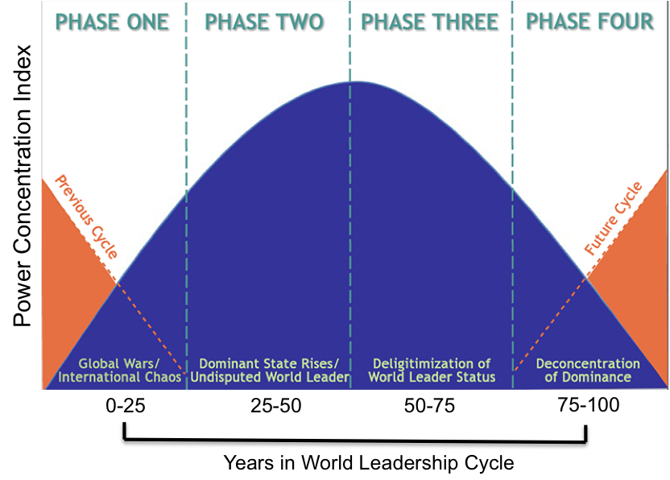
Modelski’s Important Variation:
Long Cycle Theory

Slide 41
Modelski’s Important Variation:
Long Cycle Theory
In Phase 3, the “GEOCULTURE” established by the hegemon is discredited and loses its LEGITIMACY (a cognitive, psychological, and emotional variable):

Slide 42
Modelski’s Important Variation:
Long Cycle Theory
In Phase 3, the “GEOCULTURE” established by the hegemon is discredited and loses its LEGITIMACY (a cognitive, psychological, and emotional variable):
The Hegemon’s Behavior Changes: Feeling the strain, the world leader may start acting more unilaterally and coercively to preserve its status. Its policies can appear more self-serving and less focused on providing global public goods. It becomes erratic, and others find this disconcerting.

Slide 43
Modelski’s Important Variation:
Long Cycle Theory
In Phase 3, the “GEOCULTURE” established by the hegemon is discredited and loses its LEGITIMACY (a cognitive, psychological, and emotional variable):
The Hegemon’s Behavior Changes: Feeling the strain, the world leader may start acting more unilaterally and coercively to preserve its status. Its policies can appear more self-serving and less focused on providing global public goods. It becomes erratic, and others find this disconcerting.
Rivals’ Perceptions Change: Rising powers no longer view the hegemon's leadership as a benefit or as just. Instead, they begin to see the leader and the rules of its order as obstacles to their own ambitions and as sources of injustice. The hegemon's actions are no longer interpreted as benevolent leadership but as self-interested dominance. The hegemon inspires anxiety.

Slide 44
Modelski’s Important Variation:
Long Cycle Theory
In Phase 3, the “GEOCULTURE” established by the hegemon is discredited and loses its LEGITIMACY (a cognitive, psychological, and emotional variable):
The Hegemon’s Behavior Changes: Feeling the strain, the world leader may start acting more unilaterally and coercively to preserve its status. Its policies can appear more self-serving and less focused on providing global public goods. It becomes erratic, and others find this disconcerting.
Rivals’ Perceptions Change: Rising powers no longer view the hegemon's leadership as a benefit or as just. Instead, they begin to see the leader and the rules of its order as obstacles to their own ambitions and as sources of injustice. The hegemon's actions are no longer interpreted as benevolent leadership but as self-interested dominance. The hegemon inspires anxiety.
The “Babel of Voices:” This is where the ideational collapse becomes obvious. The shared consensus on how the world should be run disappears. As Modelski describes it, the system dissolves into “a Babel of conflicting and mutually unintelligible voices.”

Slide 45
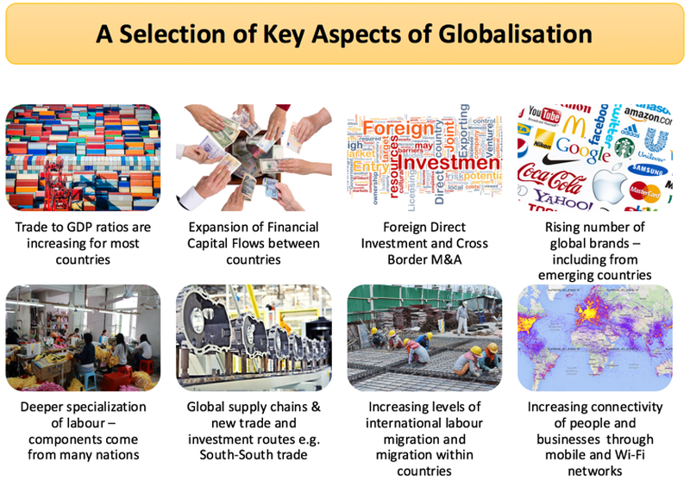
But what about GLOBALIZATION?
SOURCE: https://www.tutor2u.net/business/reference/factors-that-have-contributed-to-globalisation

Slide 46
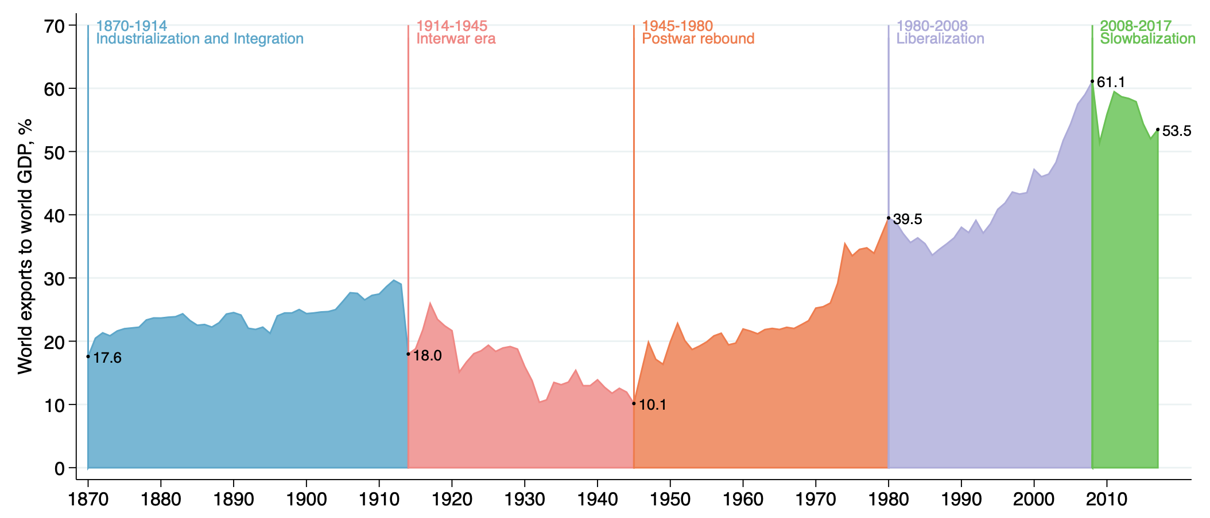
https://cepr.org/voxeu/columns/globalisation-and-global-crises

Slide 47
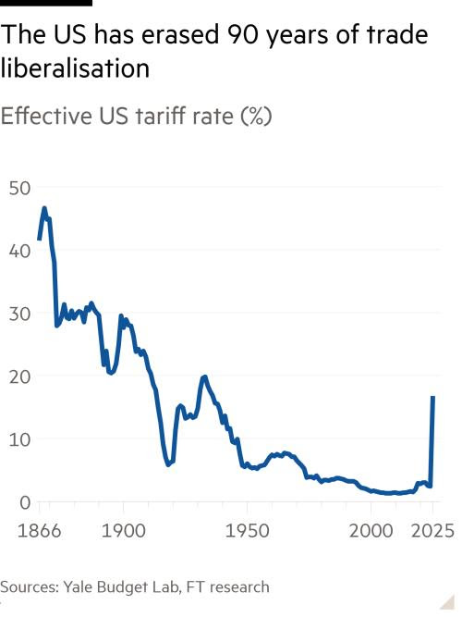

Slide 48
What IS globalization?
Stretching
Thickening
Accelerating
Deepening

Slide 49
Stretching
Stretching refers to how social, political, and economic activities expand across political frontiers—to the point that events, decisions, and activities in one region of the world come to have significance for individuals and communities in places far away.

Slide 50
Thickening
  Thickening indicates the growing magnitude of interconnectedness in almost every sphere of social existence worldwide—not just the economic and the cultural, for example, but also the ecological, epidemiological, and so on.

Slide 51
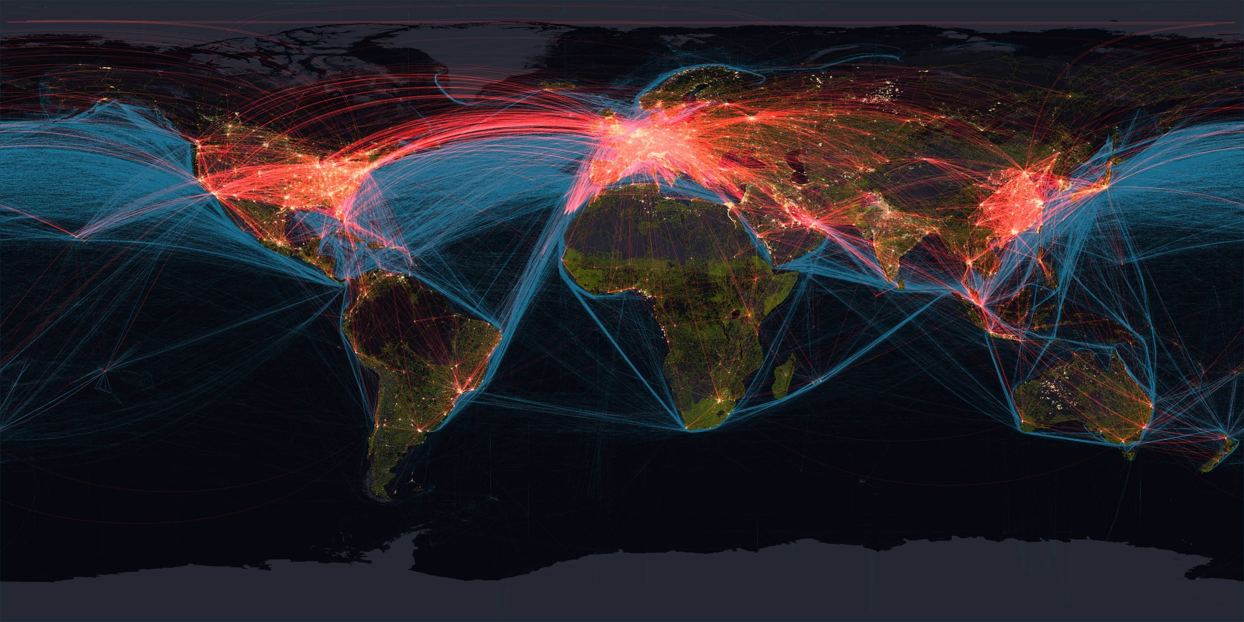
Global transportation networks
(green: roads / blue: shipping / red: air)
SOURCE: https://imgur.com/gallery/MItUKcO

Slide 52
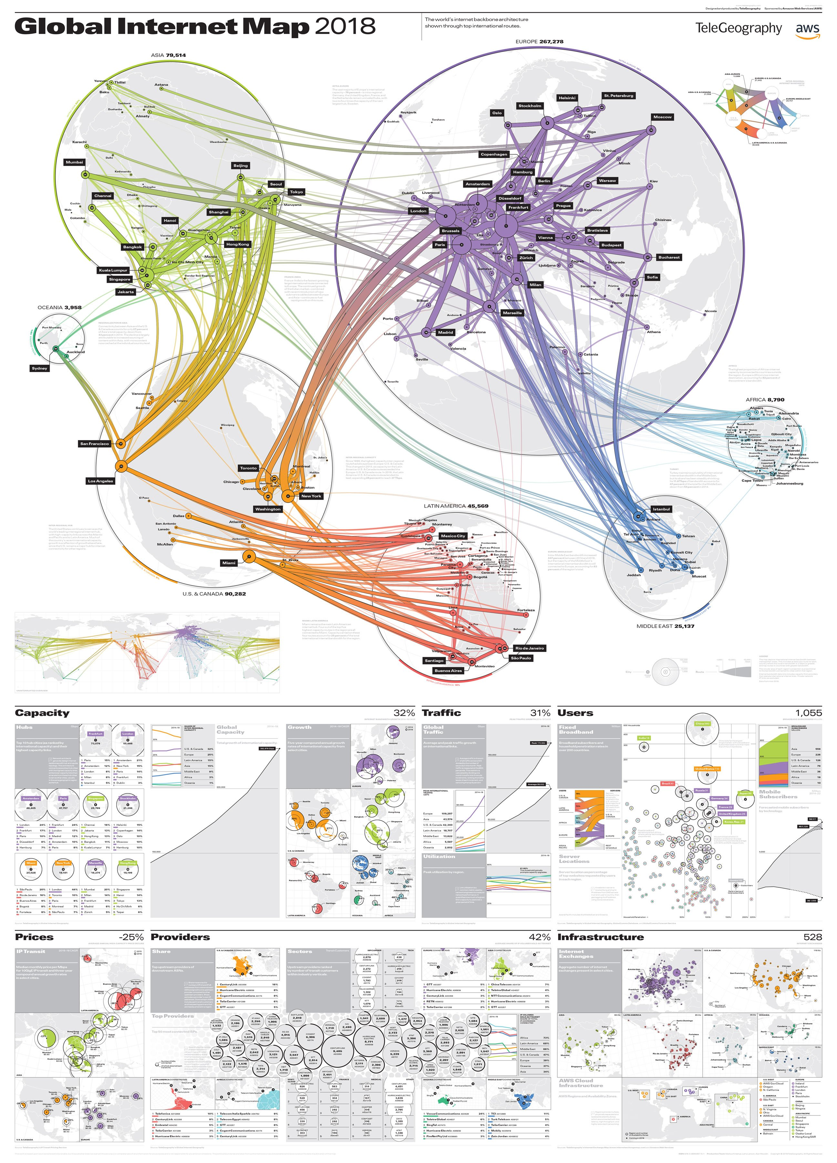

Slide 53
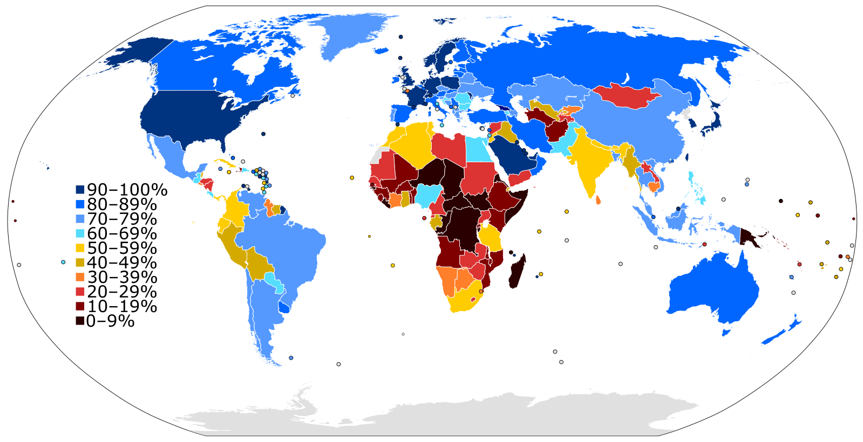
Internet penetration rate, 2023
SOURCE: https://en.m.wikipedia.org/wiki/File:InternetPenetrationWorldMap.svg

Slide 54
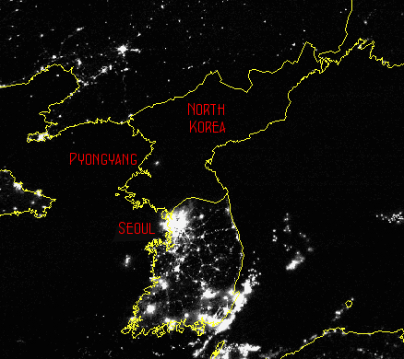
Nighttime on the Korean Peninsula

Slide 55
Accelerating
Accelerating indicates how new transportation and communications technologies increase the velocity at which ideas, news, goods, information, and capital—plus technology itself, and microbes—move around the world.

Slide 56
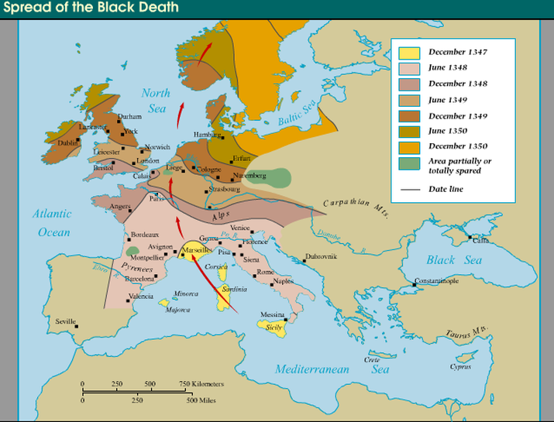

Slide 57
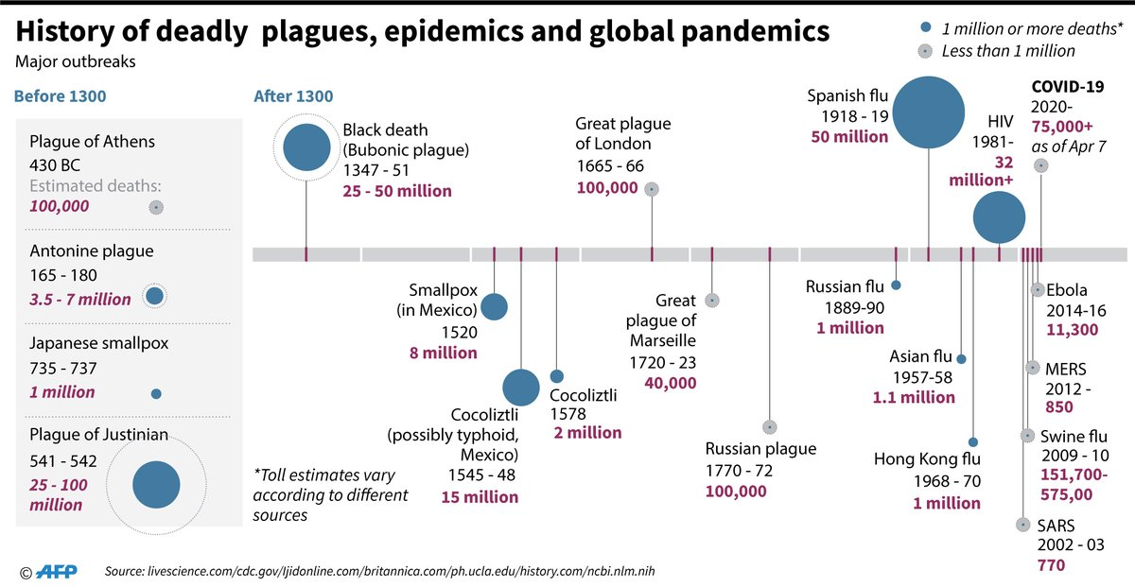

Slide 58
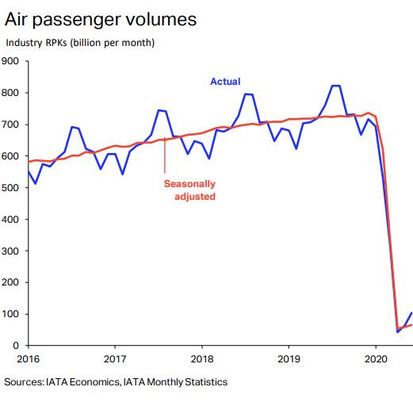
RPK = revenue passenger kilometers

Slide 59
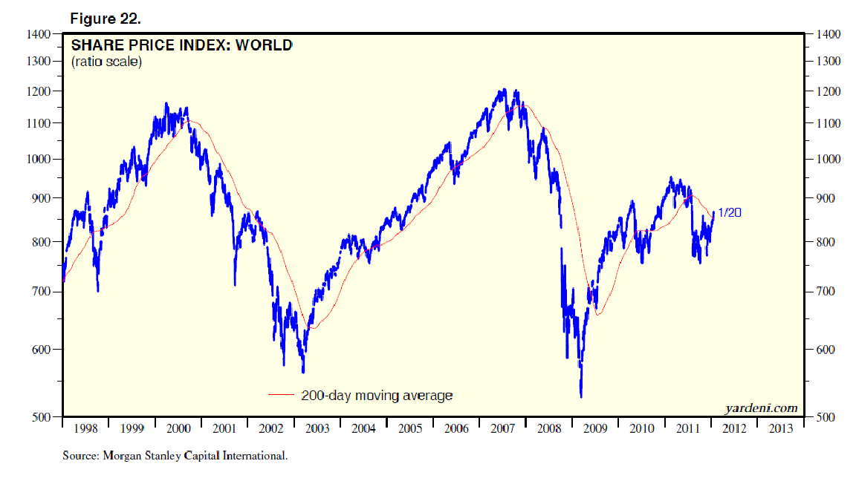
Financial crises these days quickly become global
SOURCE: http://blog.yardeni.com/2012/01/world-stock-prices.html

Slide 60
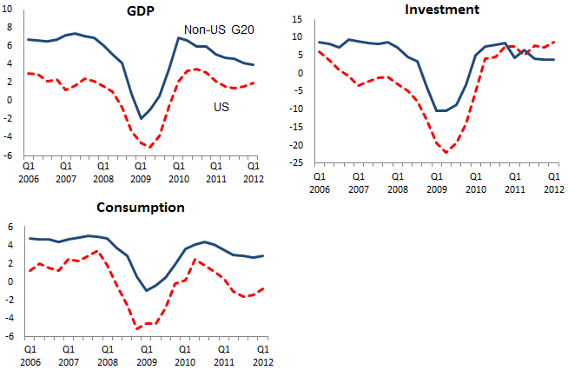
The Great Recession (2007-2009)
SOURCE: https://voxeu.org/article/explaining-global-great-recession

Slide 61
Deepening
Deepening refers to how stretching, thickening, and accelerating all COMBINE to produce an enmeshing of local and global experience (both good and bad). The boundaries disappear.

Slide 62
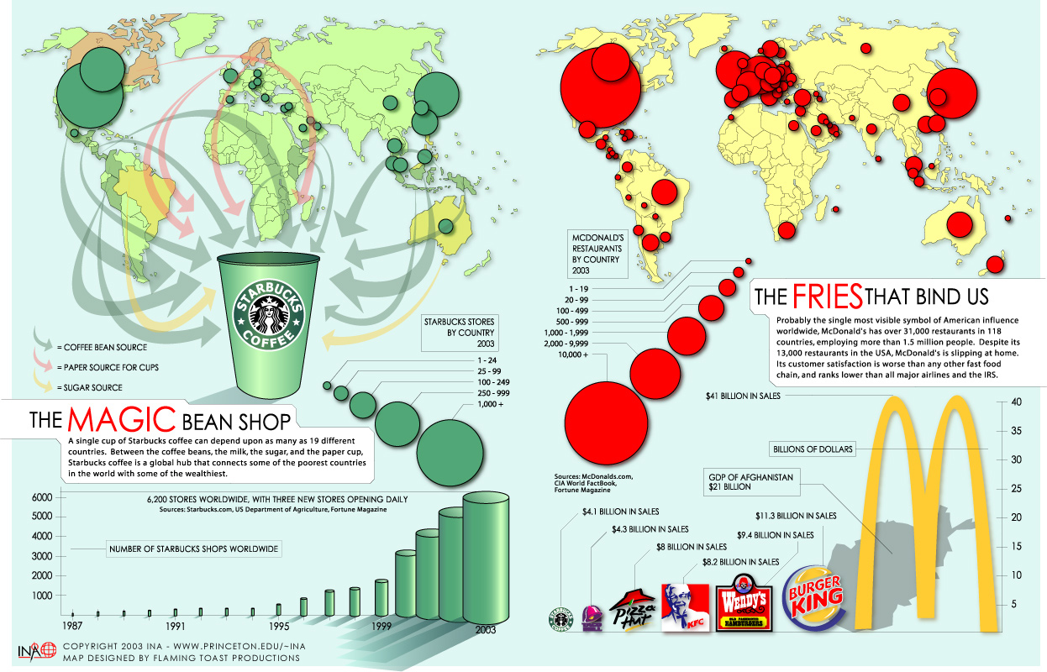

Slide 63
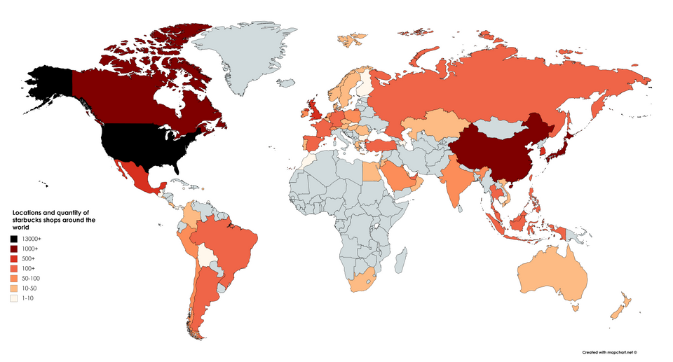
The global reach of Starbucks

Slide 64
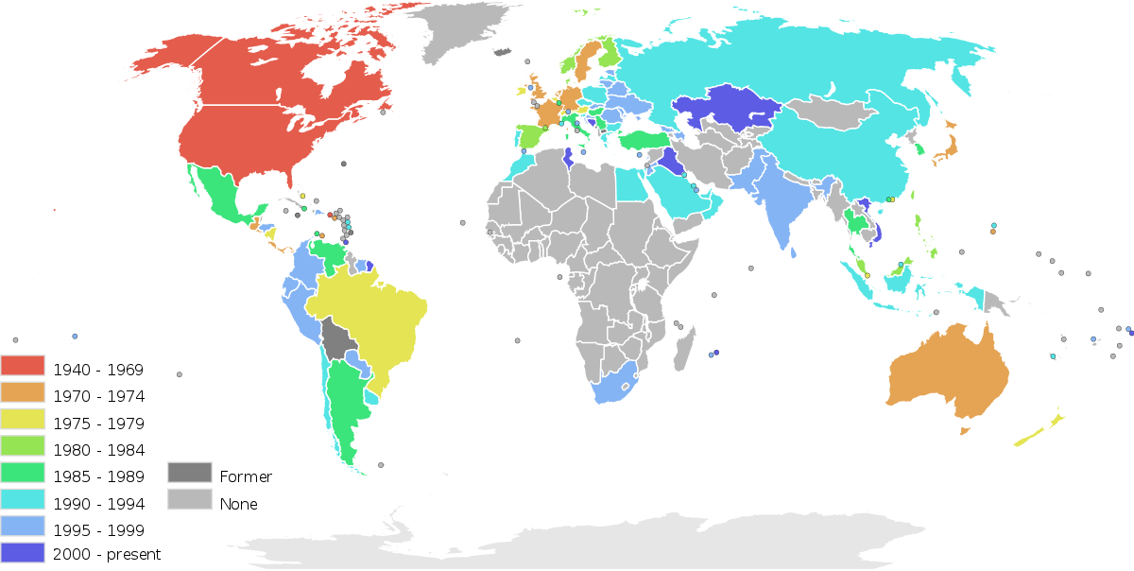
The expansion of McDonald’s

Slide 65

Is he “woke”?

Slide 66
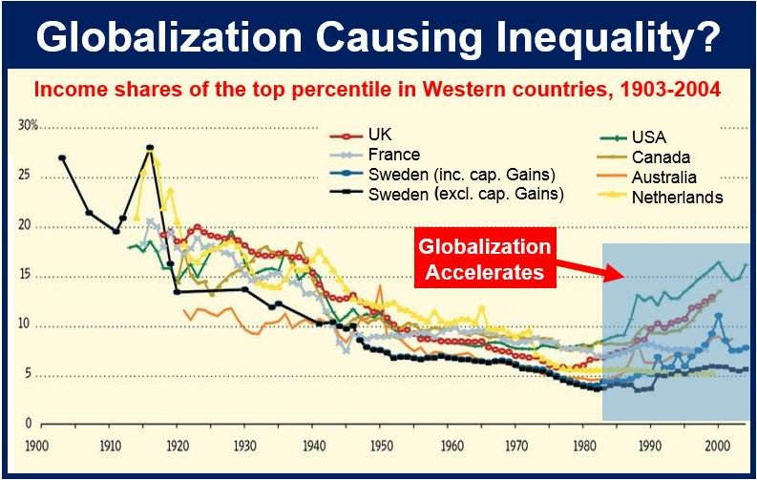

Slide 67
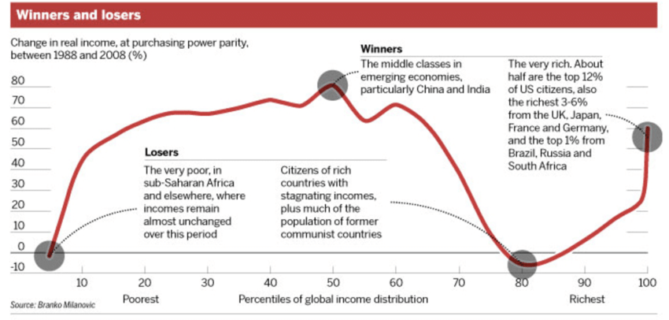
SOURCE: https://www.researchgate.net/figure/Winners-and-losers-of-globalization_fig2_321866876

Slide 68
Globalization as a Response to
Hegemonic Stagnation and Decline
The 1980-2026 era of globalization is distinct from earlier periods of trade expansion insofar as it is characterized by two main features that reinforce the core-periphery structure:

Slide 69
Globalization as a Response to
Hegemonic Stagnation and Decline
The 1980-2026 era of globalization is distinct from earlier periods of trade expansion insofar as it is characterized by two main features that reinforce the core-periphery structure:
The Globalization of Production: The defining feature of this era is the ability of multinational corporations to create a “global assembly line.” From a structuralist perspective, this is the primary mechanism of modern exploitation. It allows core-based firms to extract surplus value not just by trading finished goods for raw materials, but by directly exploiting cheaper labor in the periphery and semi-periphery for different stages of the production process.

Slide 70
Globalization as a Response to
Hegemonic Stagnation and Decline
The 1980-2026 era of globalization is distinct from earlier periods of trade expansion insofar as it is characterized by two main features that reinforce the core-periphery structure:
The Globalization of Production: The defining feature of this era is the ability of multinational corporations to create a “global assembly line.” From a structuralist perspective, this is the primary mechanism of modern exploitation. It allows core-based firms to extract surplus value not just by trading finished goods for raw materials, but by directly exploiting cheaper labor in the periphery and semi-periphery for different stages of the production process.
Financialization and Institutional Enforcement: The deregulation of financial markets allows capital to flow across borders with unprecedented speed. This isn't just about efficiency; it's a tool of power. The IMF and the World Bank are not neutral arbiters (as liberals might argue) but as enforcers of the core's interests, imposing neoliberal policies (structural adjustment, austerity) on peripheral states and ensuring they remain open to penetration by core capital.

Slide 71
Globalization as a Response to
Hegemonic Stagnation and Decline
This intensified globalization, while temporarily solving the profitability crisis for core capital, ultimately accelerates the contradictions that lead to hegemonic decline through delegitimization and then conflict:

Slide 72
Globalization as a Response to
Hegemonic Stagnation and Decline
This intensified globalization, while temporarily solving the profitability crisis for core capital, ultimately accelerates the contradictions that lead to hegemonic decline through delegitimization and then conflict:
It speeds up uneven development, dramatically empowering certain semi-peripheral states (most notably China) that can leverage the system to become peer competitors. This creates the very rivals that will challenge the hegemon's position.

Slide 73
Globalization as a Response to
Hegemonic Stagnation and Decline
This intensified globalization, while temporarily solving the profitability crisis for core capital, ultimately accelerates the contradictions that lead to hegemonic decline through delegitimization and then conflict:
It speeds up uneven development, dramatically empowering certain semi-peripheral states (most notably China) that can leverage the system to become peer competitors. This creates the very rivals that will challenge the hegemon's position.
It deepens global inequality, creating widespread social and political instability both within and between countries. This fuels resistance, from grassroots social movements to terrorist networks, further undermining global order.

Slide 74
Globalization as a Response to
Hegemonic Stagnation and Decline
This intensified globalization, while temporarily solving the profitability crisis for core capital, ultimately accelerates the contradictions that lead to hegemonic decline through delegitimization and then conflict:
It speeds up uneven development, dramatically empowering certain semi-peripheral states (most notably China) that can leverage the system to become peer competitors. This creates the very rivals that will challenge the hegemon's position.
It deepens global inequality, creating widespread social and political instability both within and between countries. This fuels resistance, from grassroots social movements to terrorist networks, further undermining global order.
It exposes the hegemon's hypocrisy. As the hegemon uses its power more overtly to protect its own declining economic position, its claim to be acting for the global good loses credibility. This is the essence of delegitimization, which erodes the consent that underpins the hegemonic order and invites challenges.

Slide 75
POWER

Slide 76
POWER
McGrew: “A ‘shrinking world’ implies that sites of power and the subjects of power quite literally may be continents apart.

Slide 77
POWER
McGrew: “A ‘shrinking world’ implies that sites of power and the subjects of power quite literally may be continents apart.
Power, whether economic, political, cultural, or military, is increasingly organized and exercised at a distance.”

Slide 78
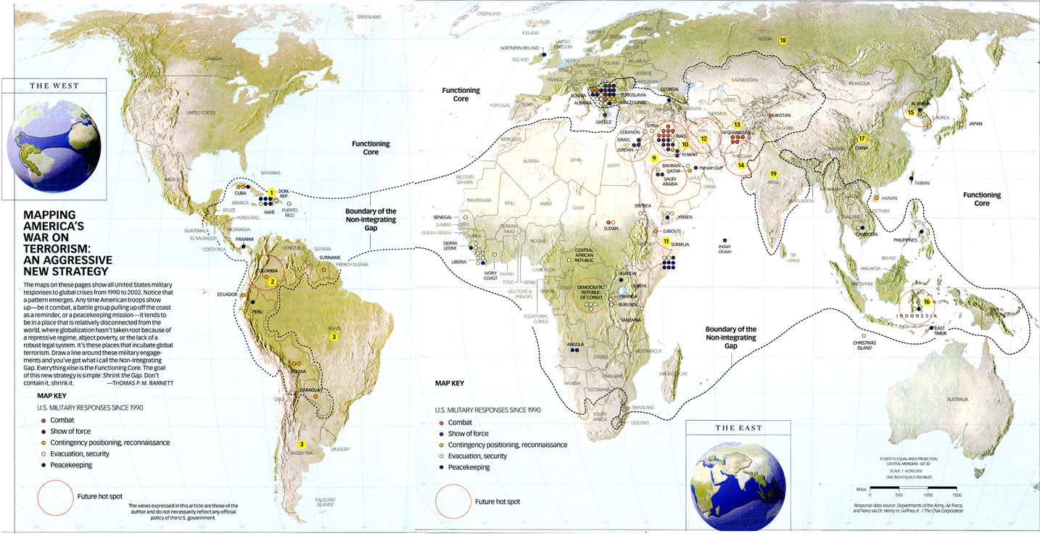
US application of military force abroad since 1991

